Slide 1
The experiment will take approximately 1h30min – 2h, and it’s composed of 3 big sessions
Running experiment is very straight forward:
Simply run the code and choose the right condition
Here are the steps:
Greeting participant & eye acuity test
Instruct the participant with ‘Instruction for observers_0_general.pptx’
Check experimental order (randomized across-participant, page 2)
Calibrate eye-tracker with eyelink software (details to page 3)
Run training session (18 trials, details to page 4)
Calibrate eye-tracker and Run main session
Repeat 4-6 3 times
Ask if the participant perceived group motion or not (question to page 5) and complete participant information in Logbook.xlsx

Slide 2
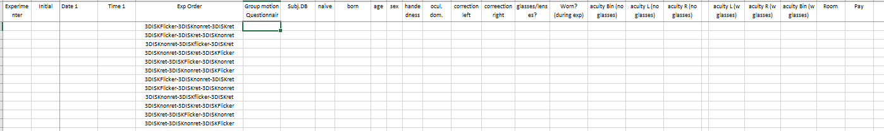
STEP 3: Check experimental order (in Logbook)
You can fill in the participant information one by one to ‘Logbook.xlsx’
Experimental order is specified in ‘Exp order’ column
3DISKFlicker : ‘train_3disk_flicker’ & ‘main_3disk_flicker’
3DISKnonret : ‘train_3disk_nonret’ & ‘main_3disk_nonret’
3DISKret : ‘train_3disk_ret’ & ‘main_3disk_ret’

Slide 3
STEP 4: Connect and calibrate with eyelink software (@Martin could you add information here plz?)

Slide 4
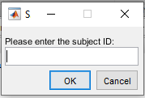
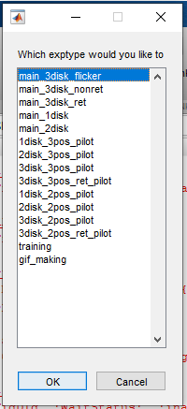
STEP 5&6: Running the code (‘TPD_PriorityMap_Run.m’)
Run TPD_PriorityMap_Run.m code
Enter subject ID (i.e., subject’s initial: OHC for Oh-hyeon Choung)
Choose the condition (i.e., main_3disk_flicker for the 3DISKFlicker condition)

Slide 5
STEP 8: Group motion questionnaire and Logbook.xlsx
At the end of the experiment, ask if the participant perceived group motion in 3DISKnonret and 3DISKret condition or not (1-5 scale).
Question: What was your perception of 3 disks? Moving left-and-right in concert or flickering on-and-off? (1) each disk was flickering on-and-off → (5) 3 disks were moving left-and-right in concert
Fill the ‘Group motion questionnaire’ column
Also, fill the other columns in Logbook.xlsx, there are two sheets in the excel file:
Participants List: all the information related to the participant
Notes: any kinds of notes regarding each participant

